Slide 1
IEEE ICC 2022
Pattern-Division Multiplexing for
Continuous-Aperture MIMO
Zijian Zhang and Linglong Dai
16th May 2022
Notes:
Nice to meet you every one! I am Zijian Zhang from Tsinghua University. Today I wish to introduce our recent work titled “Pattern-Division Multiplexing for Continuous-Aperture MIMO”.

Slide 2
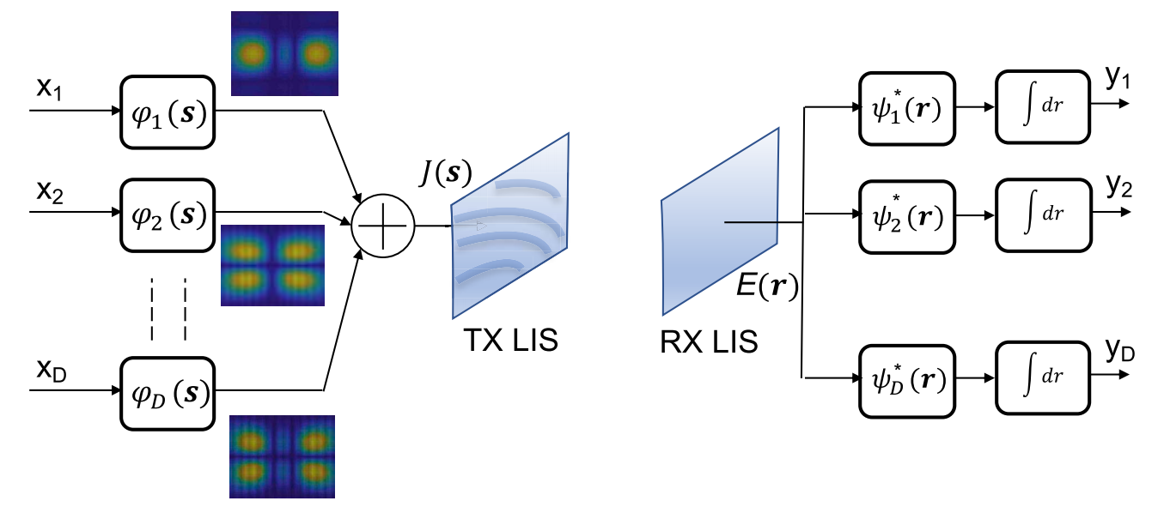
Continuous-aperture MIMO (CAP-MIMO)
continuous-aperture MIMO (CAP-MIMO)
Holographic MIMO, large intelligent surface
The current density (pattern) is generated on the aperture of CAP-MIMO transmitter and the information-carrying electromagnetic wave is induced at the receiver
A. Pizzo, T. L. Marzetta and L. Sanguinetti, "Spatially-stationary model for holographic MIMO small-scale fading," IEEE J. Sel. Areas Commun., vol. 38, no. 9, pp. 1964-1979, Sep. 2020.
Notes:
At first, I would like to introduce the concept of CAP-MIMO. Continuous aperture MIMO, namely cap-mimo, also known as holographic MIMO or active intelligent hypersurface, is considered to be a typical example of the application of electromagnetic information theory. The earliest holographic MIMO concept was proposed by Professor marzetta in New York University to maximize the ultimate performance of wireless communications. An ideal cap-mimo can be considered as a fully adjustable quasi continuous electromagnetic surface, which can fully reconstruct the current density distribution on its surface to induce the information-carrying electromagnetic field in space, so as to actively send and receive the spatial electromagnetic waves.

Slide 3
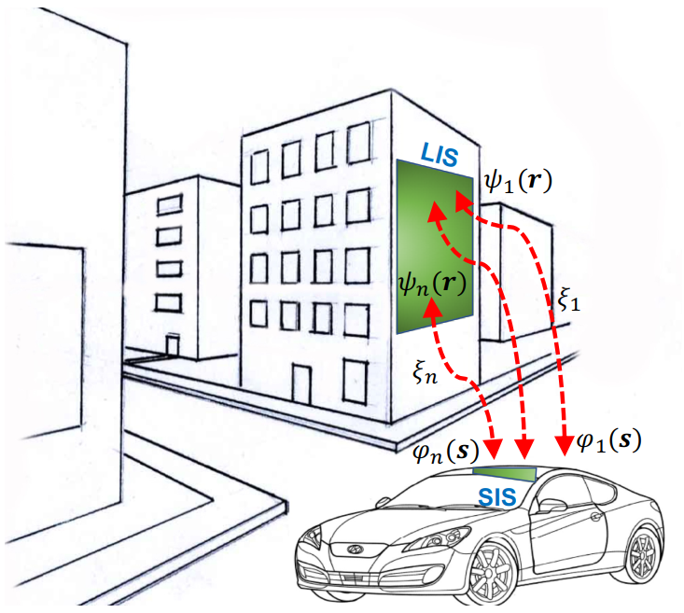
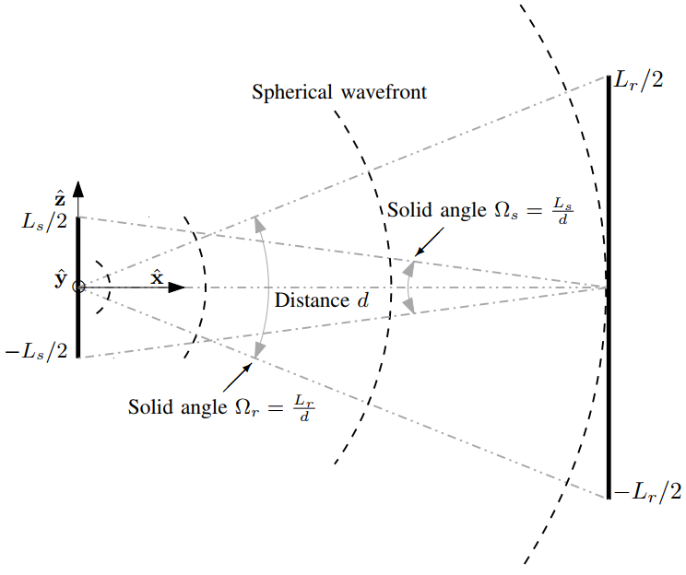
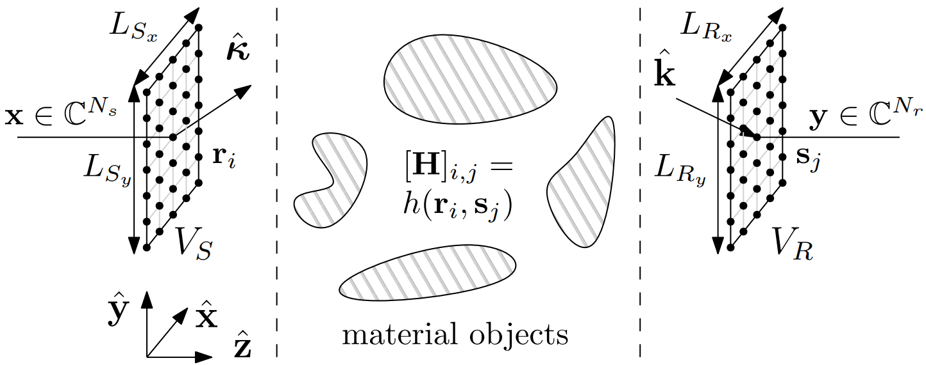
CAP-MIMO: Prior works
Channel modeling：Modeling small-scale fading of electromagnetic channel with Gaussian random field in wavenumber domain^{[1]}
DoF analysis: degrees of freedom of communication between two CAP-MIMO is analyzed^{[2]}
Transmission method: wavenumber-division multiplexing is proposed to modulate symbols on different wavenumbers^{[3]}
[1]
[2]
[3]
[1] A. Pizzo, T. L. Marzetta and L. Sanguinetti, "Spatially-stationary model for holographic MIMO small-scale fading," IEEE J. Sel. Areas in Commun., vol. 38, no. 9, pp. 1964-1979, Sep. 2020.
[2] D. Dardari, "Communicating with large intelligent surfaces: Fundamental limits and models," IEEE J. Sel. Areas Commun., vol. 38, no. 11, pp. 2526-2537, Nov. 2020.
[3] L. Sanguinetti, A. D’Amico, M. Debbah, "Wavenumber-division multiplexing in line-of-sight holographic MIMO communications," arxiv preprint arxiv:2106.12531., Jun. 2021.
Notes:
There are many hot topics of CAP-MIMO in the existing works. For example, in the first reference, the authors proposed to model the small-scale fading of electromagnetic channel with Gaussian random field in wavenumber domain. Then, in the second reference, the authors have analyzed the degrees of freedoms between a couple of CAP-MIMO, and many insightful results are obtained and many interesting phenomenons are revealed. Recently, in the third reference, the authors proposed a wavenumber-division multiplexing method to modulate different symbols on different wavenumbers. In this way, a multi-stream transmission like OFDM can be realized.

Slide 4
CAP-MIMO: Pattern-division multiplexing (PDM)
Pattern-division multiplexing: modulate symbols on multiple patterns, and realize multi-stream transmission by designing continuous pattern functions
CAP-MIMO Transmitter
Users
Combiner 1
Pattern Design
Electric field
Pattern for user 1
Combiner 2
Pattern for user 2
…
…
…
Pattern for user K
Combiner K
Electric field
Notes:
Specifically, the architecture of cap-mimo is shown above. Here, we show that a cap-mimo transmitter transmits electromagnetic signals works as a base station and several electromagnetic-wave receivers receive signals work as the users. Among them, the current density on the continuous aperture of cap-mimo can be divided into several current patterns, and different patterns are used to modulate different symbols for different users. Thus, by designing several pattern functions as orthogonal as possible, the spatial electric field induced by cap-mimo can serve several users with better performance. In this case, How to design continuous pattern functions for different users becomes our research problem.

Slide 5
PDM: System model
PDM：Sum-rate and power constraint
Achievable rate for user k：
BS transmit power：
Sum-rate
PDM：Problem formulation
Patter function
（current density）
Power constraint
Challenge：The optimization of continuous pattern functions
Z. Zhang and L. Dai, “Pattern-division multiplexing for continuous-aperture MIMO,” in Proc. 2022 IEEE International Conference on Communications (IEEE ICC’22), Seoul, South Korea, May 2020.
Notes:
In order to design the current density of cap-mimo surface, we first need to model the optimization problem. Using the mutual information formula, we can calculate the achievable rate of user K. Along with the base station transmit power constraint, we can model the multi-user sum-rate maximization problem shown above. Where Pmax is the maximum available transmit power of the base station and thetak is the current density to be optimized. By solving this problem, we can get the pattern design and the maximum users’ sum-rate. However, the difficulty in solving this problem is the optimization of nonconvex functional pragramming. Specifically, different from the traditional precoding optimization for massive MIMO, cap-mimo, as a continuous electromagnetic surface, needs to design a series of continuous pattern functions thetak, which is difficult for the existing digital signal processing methods. Therefore, the existing methods often use some special functions with good mathmatical properties to realize the heuristic design thetak.

Slide 6
PDM：Pattern design
Design pattern functions based on orthogonal basis functions
Orthogonal basis projection of patterns：
Orthogonal basis functions：
The design of pattern functions is transformed to that of projection lengths
Electric field：
Power constraint：
A general pattern design method for CAP-MIMO
Z. Zhang and L. Dai, “Pattern-division multiplexing for continuous-aperture MIMO,” in Proc. 2022 IEEE International Conference on Communications (IEEE ICC’22), Seoul, South Korea, May 2020.
Notes:
Thus, in order to solve this problem, we propose a transform method based on Fourier transform, which transforms continuous function optimization into continuous variable optimization. By introducing the Fourier basis function psi, we can expand the pattern function and project the continuous functions into the Fourier space, so that the design of the continuous function is transformed into the projection length design in the Fourier basis space. Thus, we realize the discretization of electromagnetic waves and transmit power constraint. Since then, the continuous function design is transformed into discrete vector design, and the traditional digital signal processing method can be used to optimize the precoding problem again. In this way, we actually realize a general pattern design method for CAP-MIMO.

Slide 7
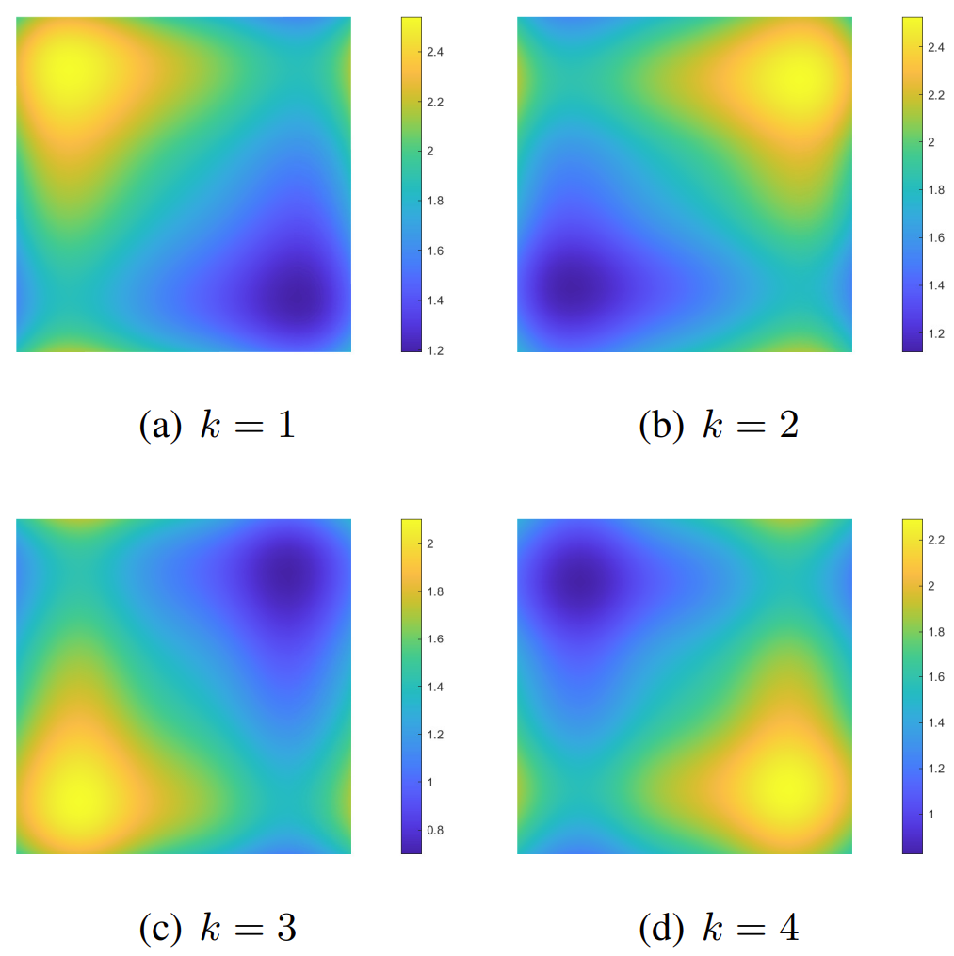
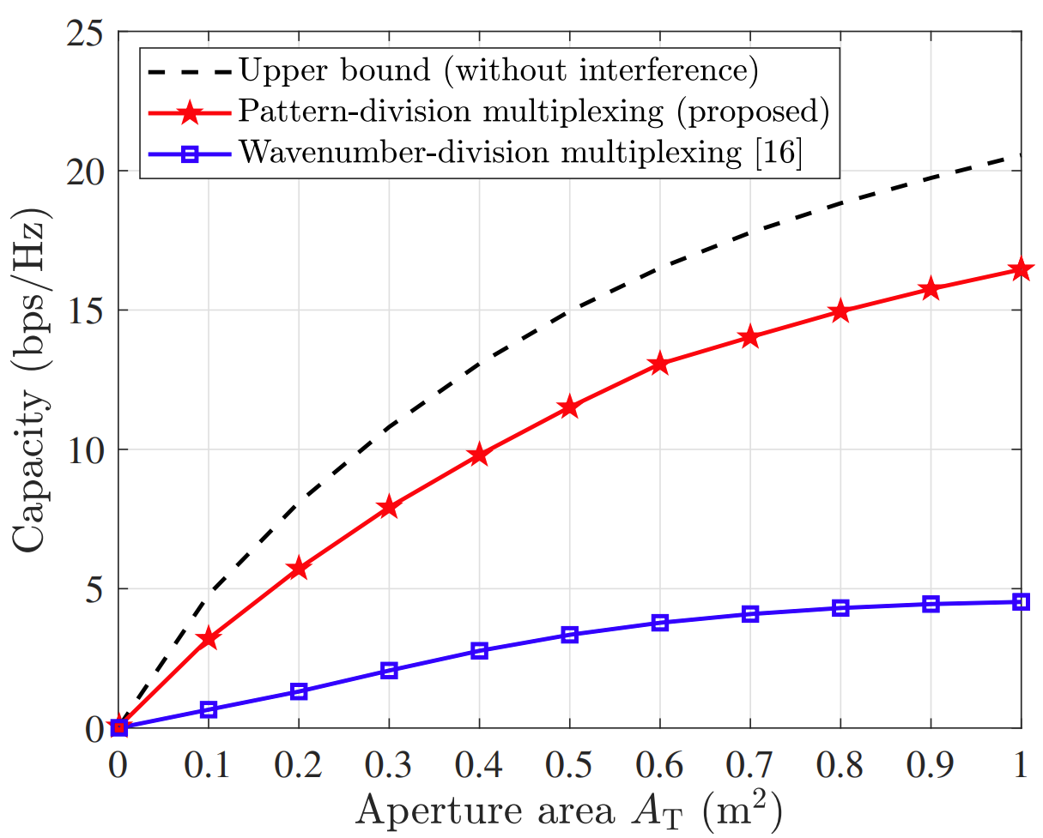
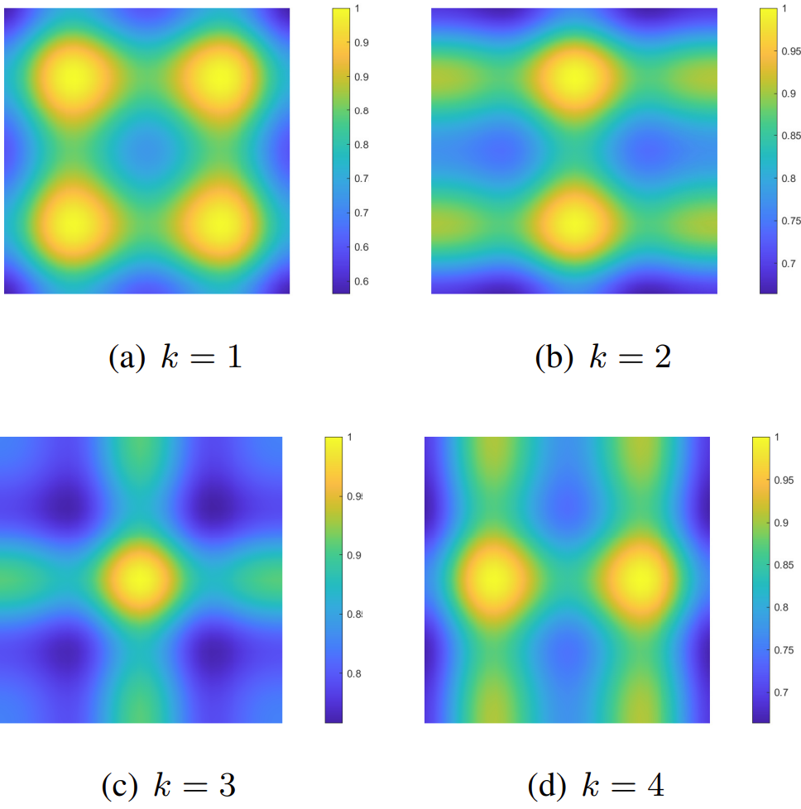
PDM: Simulation results
Simulation scenario
1 CAP-MIMO Transmitter
4 users
200%
Pattern amplitude
Pattern phase
Sum-rate vs. CAP-MIMO area
L. Sanguinetti, A. D’Amico, M. Debbah, "Wavenumber-division multiplexing in line-of-sight holographic MIMO communications," arxiv preprint arxiv:2106.12531., Jun. 2021.
Z. Zhang and L. Dai, “Pattern-division multiplexing for continuous-aperture MIMO,” in Proc. 2022 IEEE International Conference on Communications (IEEE ICC’22), Seoul, South Korea, May 2020.
Notes:
The last is our simulation results. On the left is the simulation scenario, including one cap-mimo and four electromagnetic receiving users. From the simulation results, we note that, compared with the traditional heuristic design based on special functions, the proposed continuous function design which is based on the basis expansion can nearly double the capacity compared with the "wavenumber-division multiplexing" design method in the existing literature, which is based on special functions. The patterns designed by the proposed scheme for different users are nearly orthogonal, which shows that the electromagnetic waves can reach multiple users as orthogonally as possible, and the beamforming enhancement is realized.

Slide 8
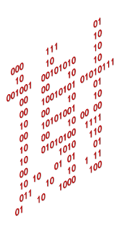
IEEE ICC 2022
Reproducible research：http://oa.ee.tsinghua.edu.cn/dailinglong/
Notes:
That would be all. Thank you for your listening.

